Slide 1
Parent mtg
9/24/19

Slide 2
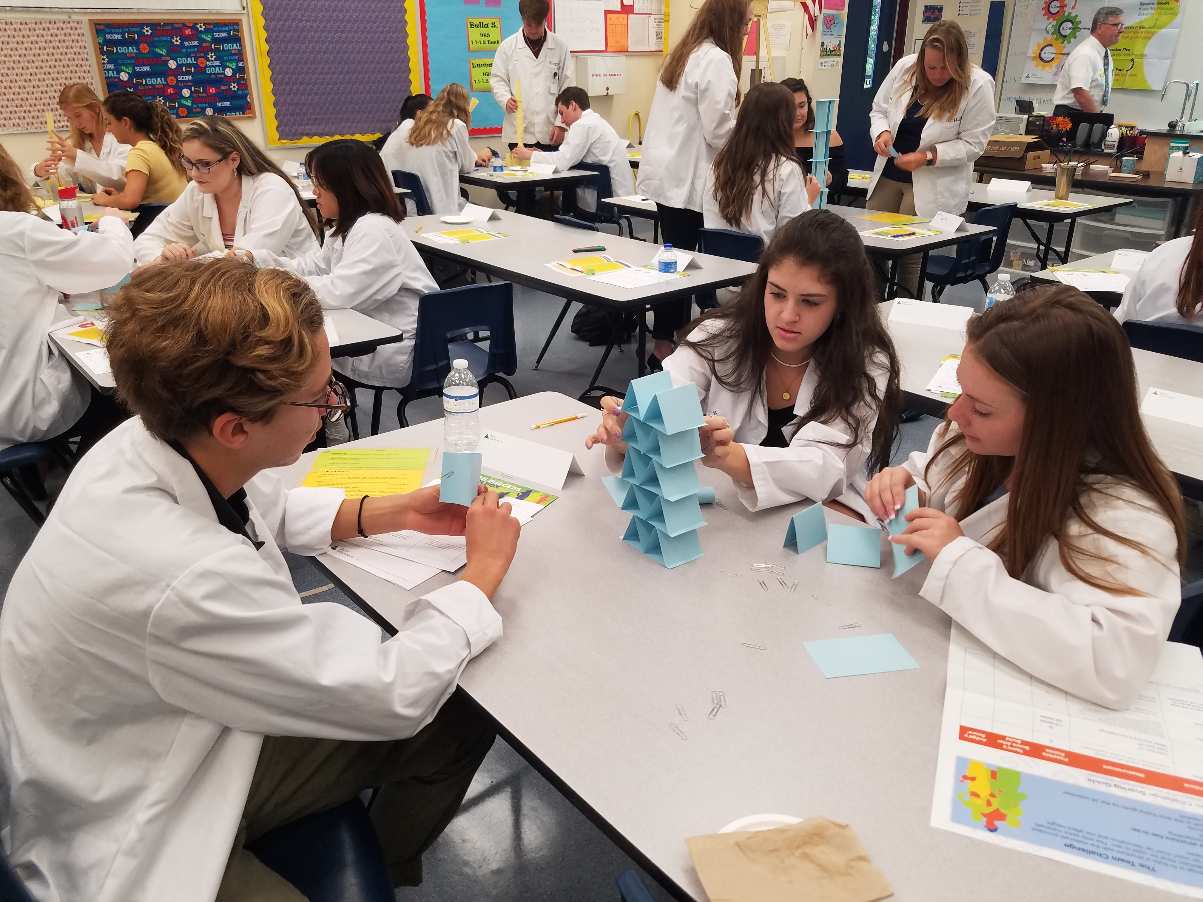
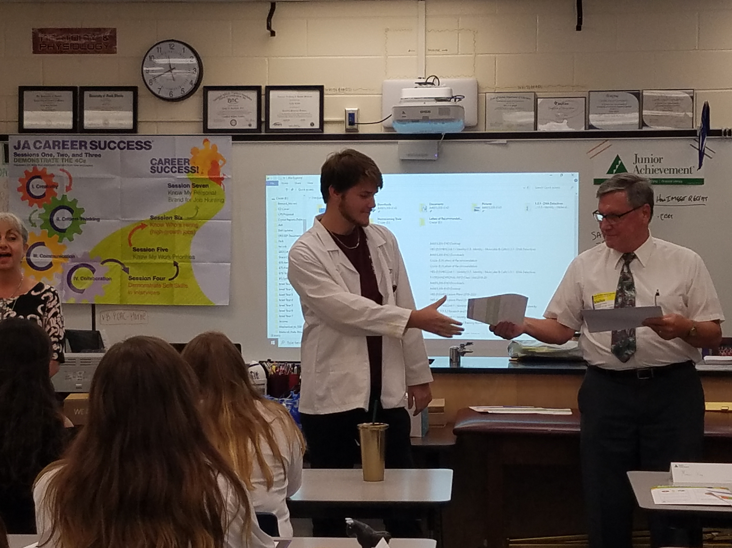
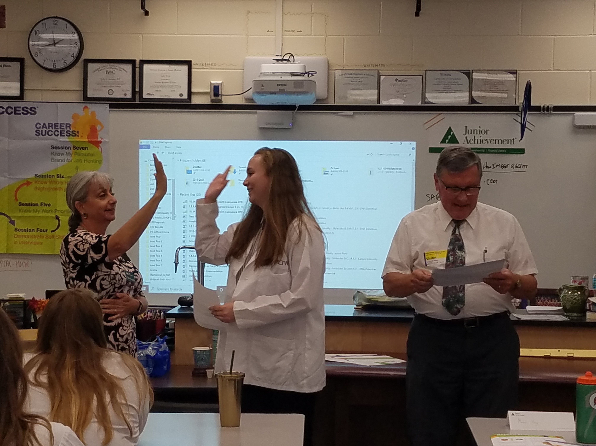
Junior Achievement
BI Seniors
Soft skills
Team building activities

Slide 3
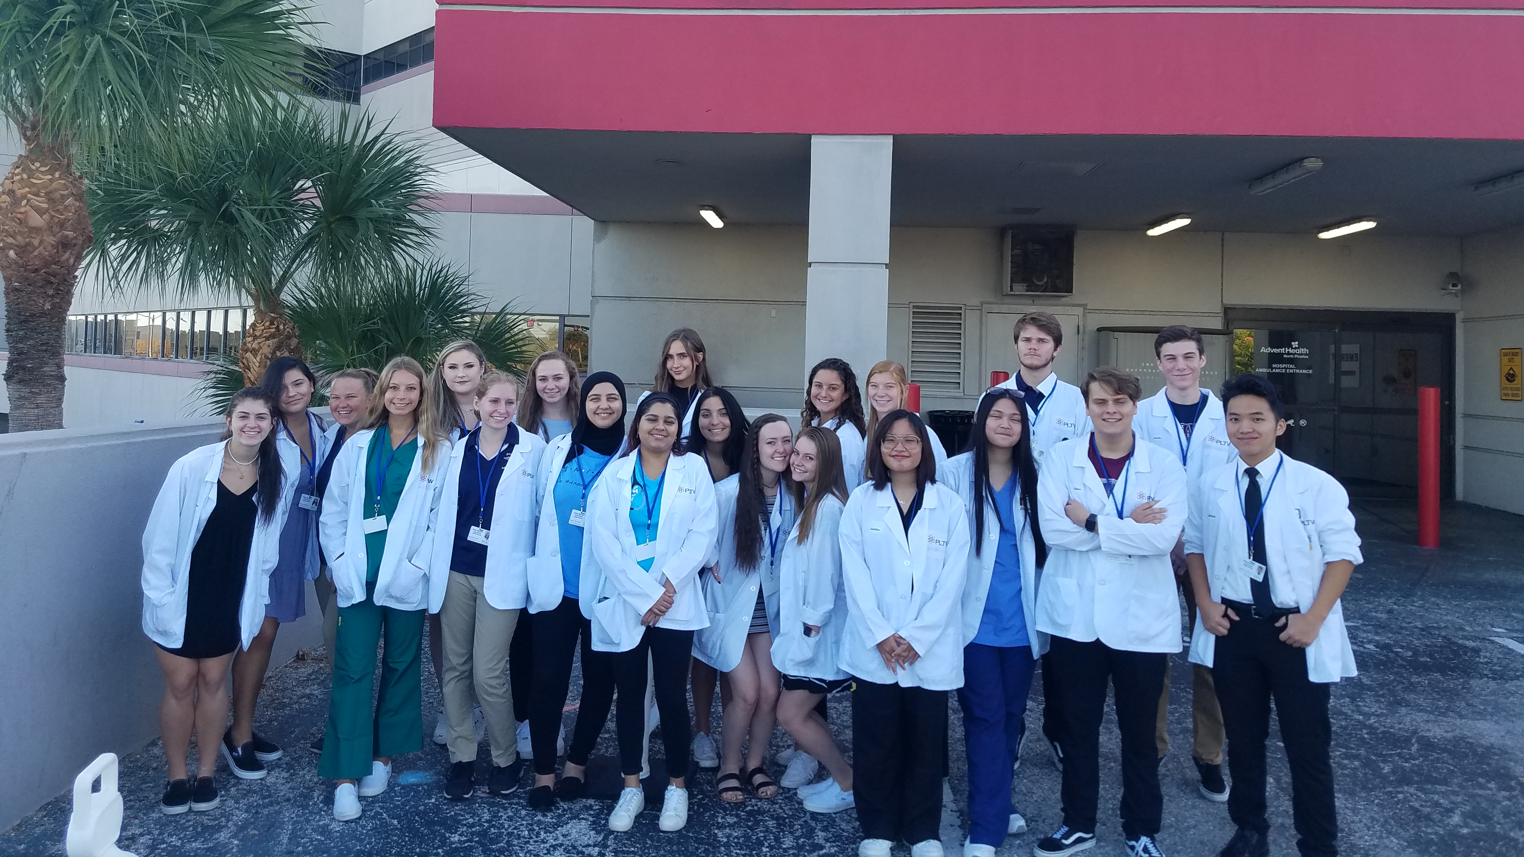
Advent health

Slide 4
From Ms. ladas
In School PSAT and SAT is on Wednesday October 16th – All 9th and 10th grade students will test, 11th and 12th grade had to opt-in for testing. Students should bring their own pencils and calculators
College Application week for Seniors will be October 21st- 25th. Career lab at school will be staffed all week by counselors to help seniors with their college applications
There is Financial Aide Night presentation for Junior and Senior parents on October 3rd 6-8PM in the PHUHS auditorium. This presentation will discuss Bright Futures, FAFSA, and other types of financial aide for college
Shadowing for 8th grade students will start in October- any 9th grade student who wants to act as a shadow host should see Ms. Ladas or Mrs. Spicciati
Spring term Dual Enrollment registration with SPC will open on October 23rd. Any junior or senior student who is currently in SPC classes for Fall should see Ms. Ladas in October for Spring registration paperwork.

Slide 5
Upcoming events September
24 Sep.
1st – 4th periods – BI seniors Advent Health Emergency Room Tour & Workshop
26 Sep.
3rd – 5th periods – BI seniors Mease Dunedin Emergency Room Tour & Workshop
26 Sep.
Hosa Freshman to Rusty pelican
27 Sep.
Spirit Day

Slide 6
Upcoming events October
10 Oct.
C N A Fingerprinting
14 Oct.
TWD
18 Oct.
Pink Friday
19 Oct.
Glam Run
22 Oct.
Jr Scrubs/Coats Ceremony

Slide 7
Upcoming events November
19 Nov.
EKG students to Nova
21 Nov.
SPC FT with all Seniors
25–29 Nov.
Thanksgiving Holiday

Slide 8
Upcoming events December
20 Dec.
End of 1st Semester
23 Dec. – 1 June
Christmas Holiday

Slide 9
Upcoming events January
1/10: Spirit Day
1/20: No School
1/28: Med Talk meeting

